Slide 1
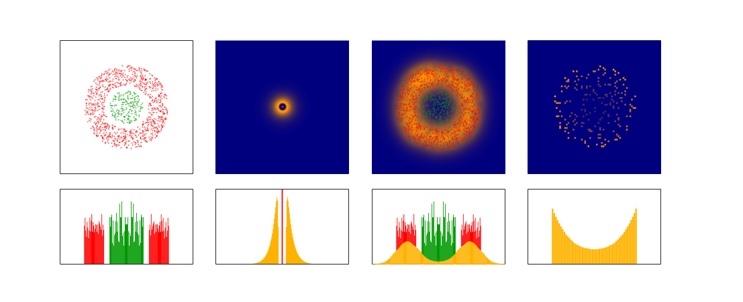
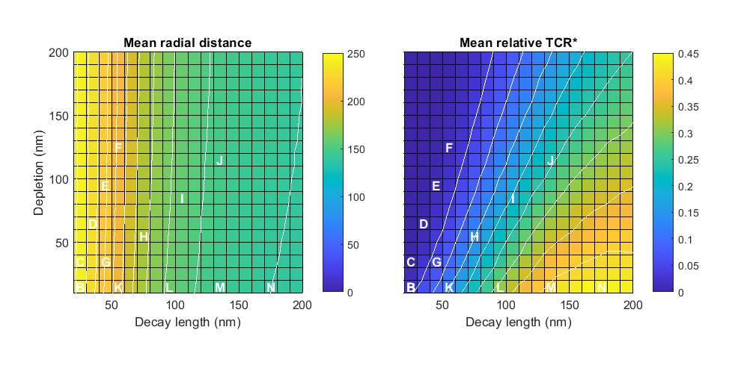
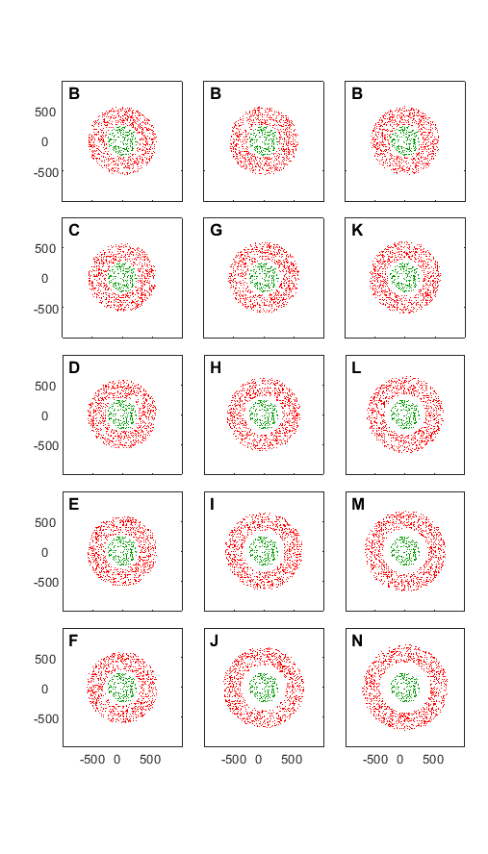
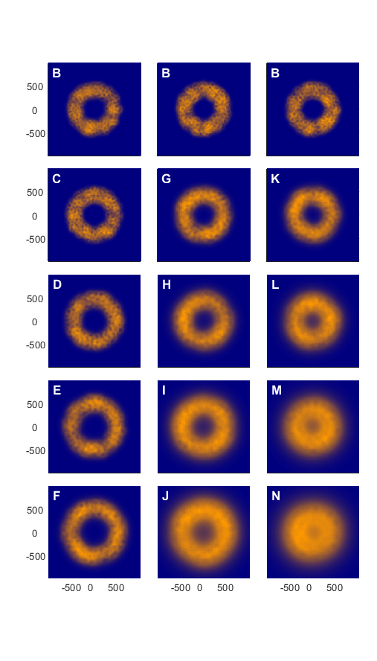
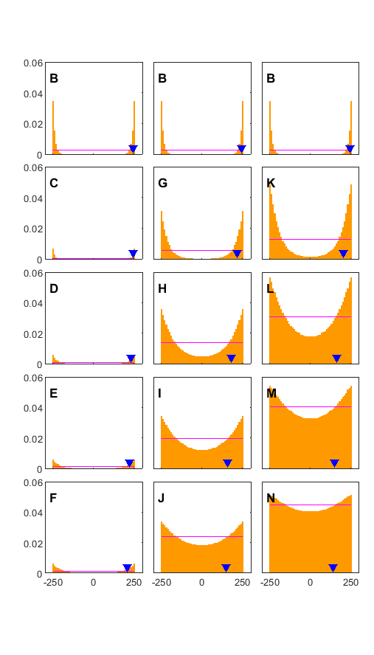
1000
Points pattern
Single CD45 phos. probability
CD45 phos. probability sum
TCR phosphorylation
TCR
CD45
CD45
TCR Phos. probability
TCR
CD45
TCR Phos. probability
y(nm)
0
-1000
Depletion
Decay length
-1000
0
1000
-1000
0
1000
-1000
0
1000
-400
0
400
x(nm)
x(nm)
x(nm)
x(nm)

Slide 2
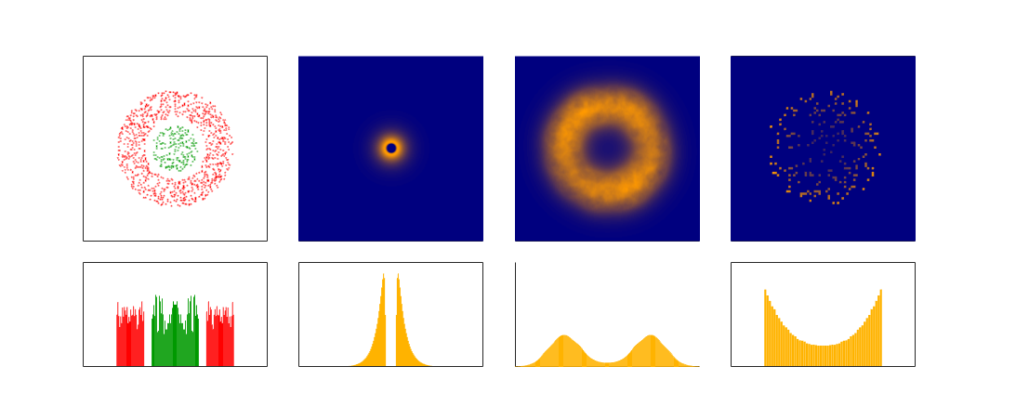

Slide 3
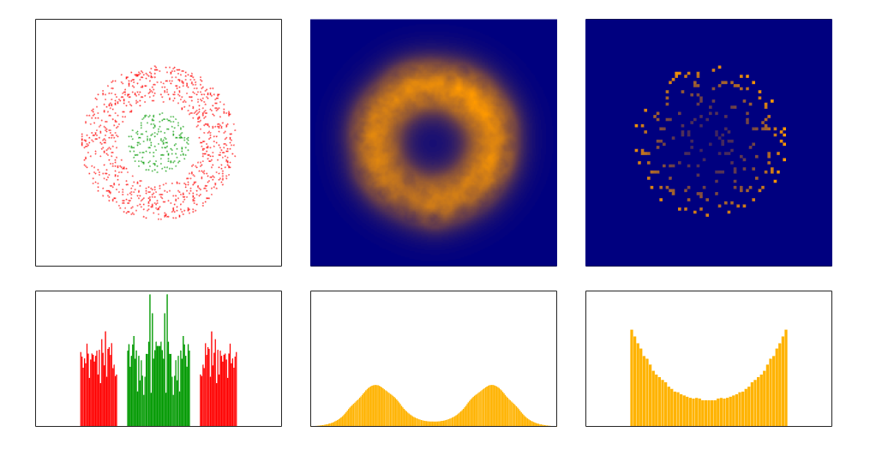

Slide 4
Depletion
Expectation
Decay length
Mean

